Slide 1
Review Accounting Journals in Workday
03/06/2026
Mary Rickard – Accountant IV - Financial Reporting, Analysis, and Systems

Slide 2
Agenda
Decision Tree for processing Journals in Workday
Journal Sources for Accounting Journals
Ledger Accounts with Spend and Revenue Categories
Process Accounting Journals in Workday
Accounting Journal Review Checks
Additional Resources

Slide 3
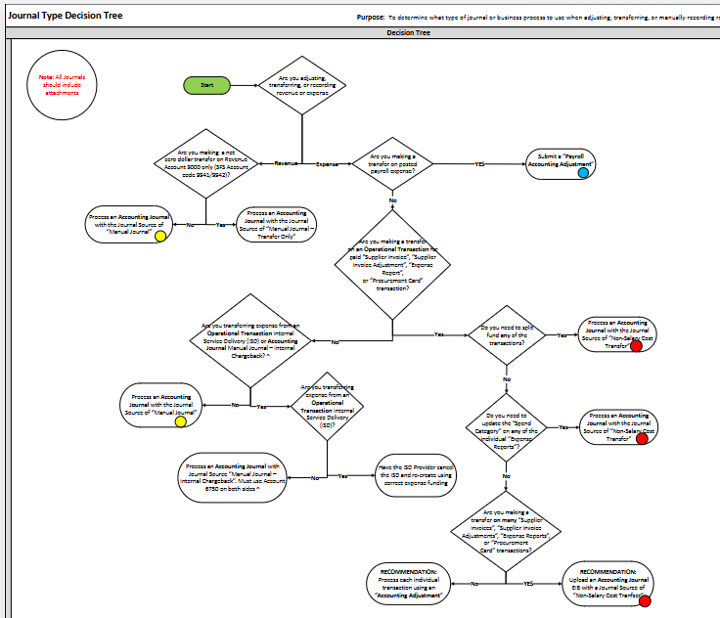
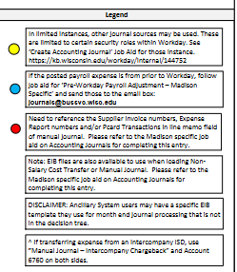
Journal Type Decision Tree
Purpose: To Determine what type of journal or business process to use when adjusting, transferring, or manually recording revenue or expenditures.
Decision Tree

Slide 4
Journal Type Decision Tree – Non Salary Cost Transfer
Versions of a Non-Salary Cost Transfer in Workday:
  Accounting Adjustment: Directly adjusts supplier invoices, supplier invoice adjustments, expense reports, or procurement card transactions in paid status.
    This process cannot be used to split fund any transactions, update the spend category on an individual expense report, or transfer multiple operational transactions at the same time.
  Manual Journal of “Non-Salary Cost Transfer” journal source: Used to transfer non salary expenses when one of the limitations of an Accounting Adjustment is present.
    Ledger Account 6750 is not allowed on this journal source

Slide 5
Journal Type Decision Tree – Non Salary Cost Transfer
Versions of a Non-Salary Cost Transfer in Workday (Cont):
  3. Manual Journal of “Manual Journal – Internal Chargeback” journal source: Specifically used to transfer expenses on Ledger Account 6750 from one funding string to another. Only to be used to correct pre-Workday internal billings on account 6750 or adjust large billings done in Workday via EIB (FPM or DoIT billing). 6750 must be used for the debit and credit.
    In general, the Internal Service Provider (ISP) should be contacted to adjust the original Internal Service Delivery (ISD) transaction as much as possible. This journal source is only intended to be a work around when the ISP can’t adjust the original ISD due to its size/nature.
RULE OF THUMB: If would have previously used Cost Transfer Tool to move the non salary expense, one of these three methods is used.

Slide 6
Journal Type Decision Tree
Versions of a Revenue Transfer in Workday:
  Manual Journal: Used when revenue or balance sheet accounts are being adjusted. Creating a manual journal that is NOT one of the following:
    A Non-Salary Cost Transfer
    A Manual Journal – Transfers ONLY on Ledger Account 9000
    A Manual Journal – Internal Chargeback on Ledger Account 6750
  Manual Journal – Transfers ONLY: Used for operational revenue transfers where Ledger Account 9000 is used on all lines of the entry.
      Not allowed on grants

Slide 7
Journal Sources for Accounting Journal
Non-Salary Cost Transfer: This journal source is used when processing non-salary cost transfers when an accounting adjustment cannot be used.
Always use spend category and expense ledger account
Manual Journal: This journal source is the standard to use when creating a manual journal and it is not a non-salary cost transfer or a revenue transfer on Ledger Account 9000.
Use spend category if moving expense
Use revenue category if moving revenue
Manual Journal – Transfer Only: This journal source is used for operational revenue transfers where Ledger Account 9000 is used on both lines of the entry.
Cannot be used on Grant Worktags
Always use account 9000 with revenue category
Manual Journal – Internal Chargeback: This journal source is only to be used to correct pre-workday internal billings on account 6750 or adjust large billings done in Workday via EIB (FPM or DoIT billing)
Always use 6750 ledger account with spend category

Slide 8
Journal Type Decision Tree
Journal sources we would NOT expect campus to use:
  Beginning Balance
  Equity Pickup
  General Ledger Conversion WEST Only
  Grants LTD Conversion WEST Only
  Grants LTD Conversion – Reversal ACP OFF WEST Only
  Manual Journal – Cost Share Only RSP Only
  Manual Journal –F&A Adjustment RSP Only
  Manual Journal – No Award Costs RSP Only
  Manual Journal – Payroll Accounting Adjustment DOBS Only
  Manual Journal – XJV UWSA Only
  Manual Journal – XML UWSA Only
  Manual Journal – Year End Adjustments DOBS Only
  Project LTD Conversion WEST Only
  Residual Balance Transfer RSP Only
  Translation Adjustment
  All SIS journal sources Bursar Office Only

Slide 9
Ledger Accounts
Ledger Account Number Range | Ledger Account Type | Normal Balance on Ledger Account
1XXX | Asset (Balance Sheet) | Debit
2XXX | Liability (Balance Sheet) | Credit
3XXX | Equity (Balance Sheet) | Credit
4XXX/9000 (Transfer Account) | Revenue (Income Statement) | Credit
5XXX | Salary, Fringe, & Financial Aid Expense (Income Statement) | Debit
6XXX (Operational Expenses)/9999 (Transfer Account) | Other Non-Salary Expense – Travel, Goods, Services, etc (Income Statement) | Debit
7XXX | Discounts and Depreciation Expense (Income Statement) | Debit
8XXX | Asset Disposal/Inventory Transfers Expense (Income Statement) | Debit

Slide 10
Spend Category/Revenue Categories
Spend/Revenue Category may be the same as the original expense/revenue, unless:
  The original spend/revenue category was “Conversion”
    “Conversion” spend/revenue categories should not be used in transactions in FY26 & forward
  The Ledger Account is being adjusted. Then need to select a spend/revenue category that aligns with the new Ledger Account you are moving the expense to.
  The spend/revenue category was originally incorrect and needs to be adjusted
To assist with Spend/Revenue Category determination:
  Using the Workday FDM - Business Services
  FDM Tool
Notes:
SC00083
SC00092
SC00071

Slide 11
Initiating Accounting Journals
Two methods/options for initiating accounting journals
  Directly in Workday via Create Journal task
    Typically used with just a few journal lines
  Using an EIB upload via Launch/Schedule Integration task
  DOBS site:
  https://businessservices.wisc.edu/accounting/workday-financial-accounting-and-pre-workday-historical-reporting/
  UW EIB Library:
  https://kb.wisconsin.edu/workday/internal/148820
Notes:
Walk thru initiating a journal directly in WD
Walk thru filling out an EIB template and loading to WD

Slide 12
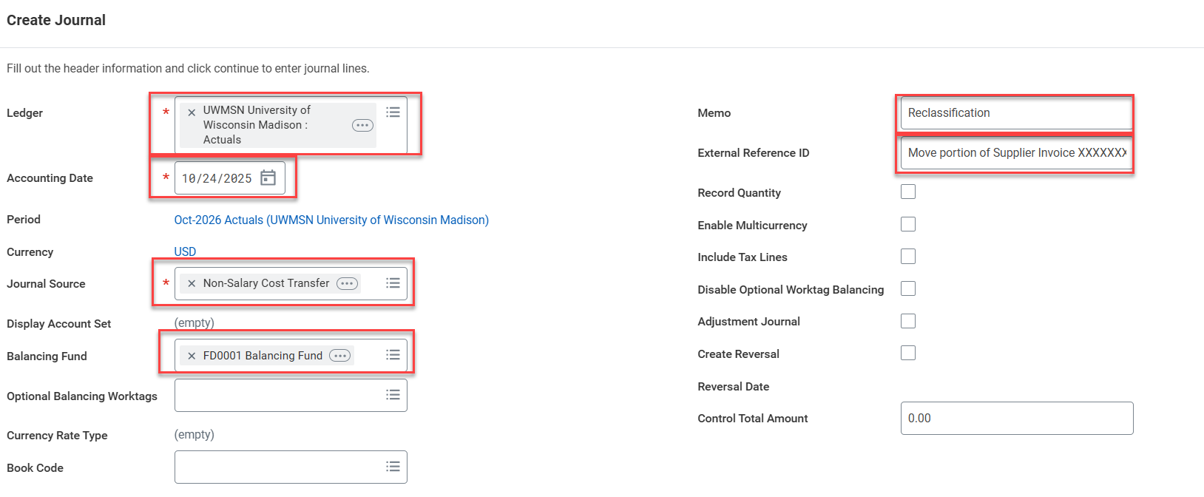
Header fields for Accounting Journal
Ledger: UWMSN: University of Wisconsin Madison : Actuals
Accounting Date: today’s date
Journal Source:
  Manual Journal
  Non-Salary Cost Transfer
  Manual Journal – Transfer Only
  Manual Journal – Internal Chargeback
Balancing Fund: FD0001
Memo: description of journal processing
External Reference: additional information on journal
**Leave Book Code blank = Common Book
**Leave Operational Balancing Worktags blank

Slide 13
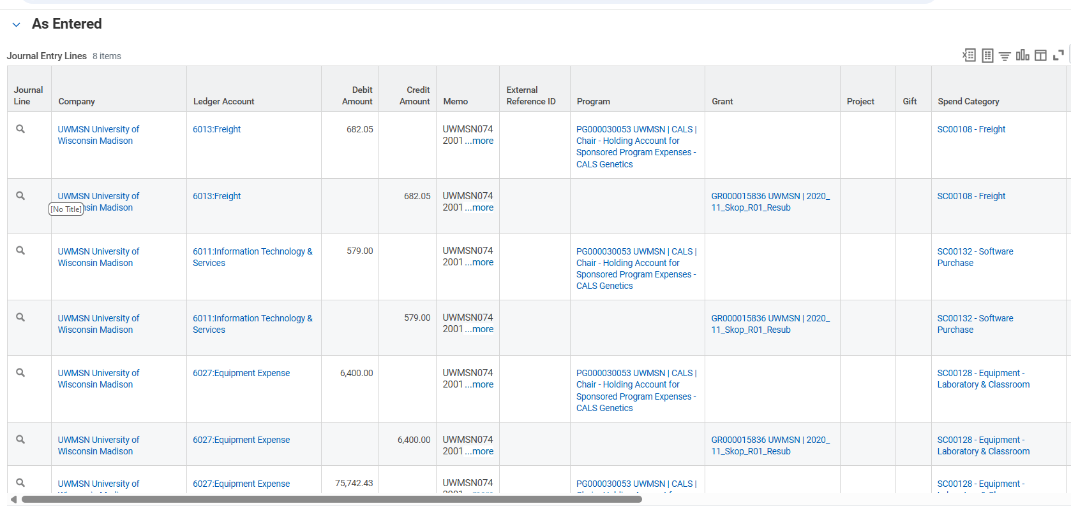
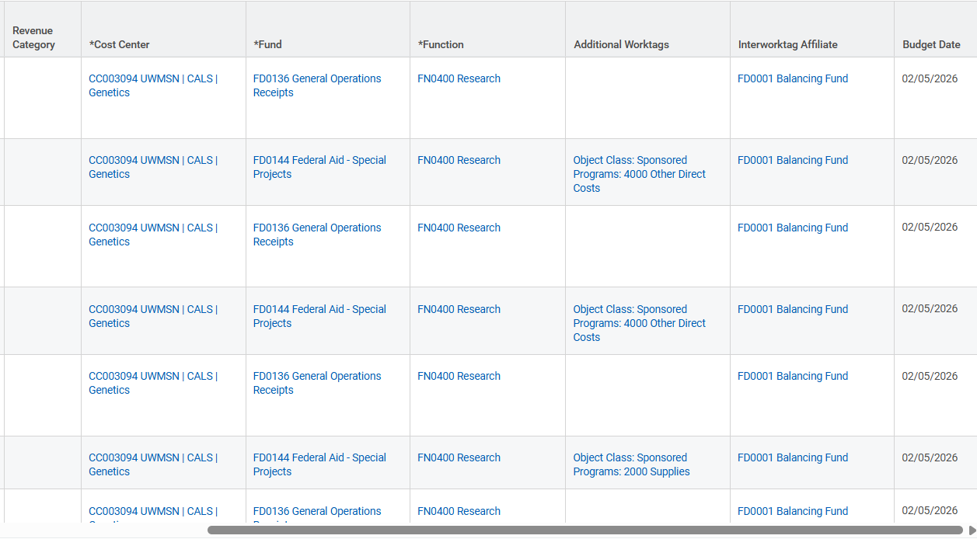
Journal Lines for Accounting Journal
Ledger Account: expense or revenue account
Debit/Credit: dollar amounts to move
Memo:
  Manual Journal/Manual Journal Transfers Only - Line description (similar to what would be entered in JET)
  Non-Salary Cost Transfer - The operational transaction number
  Manual Journal – Internal Chargeback – ISD Number
External Reference:
  Manual Journal w/ Award Costs or Manual Journal Transfer Only: Fill in when appropriate – maybe used for external voucher/invoice reference or journal reference that they may use in JET today
  Non Salary Cost Transfer/Manual Journal – Internal Transfer: Change performed on Operational Transaction and Operational Transaction number
Driver Worktag: enter the program/grant/gift/project
  Auto populates with default cost center/fund/function
  Can update those to other values if they are allowable on driver worktag
Spend Category/Revenue Category:
  Expense Ledger Account – spend category
  Revenue Ledger Account – revenue category
  Never use spend or revenue category with ‘CONVERSION’ in name

Slide 14
Creating Manual Journal– Non Salary Cost Transfer
When creating a Manual Accounting Journal to move Non Salary Costs
  Always use a spend category with the expense ledger account
  In general, the Credit column should be the costs moving From
  In general, the Debit column should be the costs moving To
    From the old NSCT Tool:
      Credit column = ‘FROM’ funding string
      Debit column = ‘TO’ funding string
  **Note: The opposite should be used if moving a discount when moving a discount (ledger account 7080) or negative expense:
    If moving an expense that is negative:
      Debit Column – original funding (FROM)
      Credit Column – new funding (TO)

Slide 15
Reminders for Accounting Journal
Ledger always ‘UWMSN ACTUALS’
Do not back-date journal entry dates or change/back date budget dates in journal lines
Only use journal sources:
    Manual Journal
    Manual Journal – Internal Chargeback (can only use account 6750/4750)
    Non Salary Cost Transfer
Balancing Fund ALWAYS FD0001
Leave ‘Book Code’ blank = Common Book
Cannot use any ledger account or spend/revenue category with ‘Conversion’ in the name
  Listing of ledger accounts with spend/revenue categories
All Journals need attachments
  Make sure support on entry gives approver all information on what the journal entry is doing; can add notes on the journal before submitting as well.
  If going to/from a grant Worktag, always need to fill out the grant questionnaire

Slide 16
Review Accounting Journal Checks
All Journals need attachments
  Correct supporting documentation is needed on all accounting journals
Verify correct journal source is being used for entry that is processed
Verify balancing fund being used is FD0001
Book code is left blank on journal
Budget date is not back dated
Confirm spend/revenue category is filled in appropriately
  No spend/revenue categories with ‘Conversion’ in the name
  Expense Ledger Account = Spend Category
  Revenue Ledger Account = Revenue Category
  When using account 6027, Equipment Expense, must fill in the Additional Worktag “Expenditure Treatment: Capital Equipment”

Slide 17
Sending Transactions Back to Initiator
Send transactions back to initiator for corrections when:
  Any item on previous slide is not correct
  Costs being transferred to or from grant worktag are not appropriate
  Change Reason entered on Accounting Adjustment or Non-Salary Cost Transfer journal is not appropriate
  Under or Over 90 Day questionnaire in Workday is not answered satisfactorily to meet compliance needs
  Under or Over 90 Day questionnaire is not ATTACHED to Non-Salary Cost Transfer (or any) accounting journal
  Any other support documents are not attached as expected
  A journal source of Manual Journal-Transfers Only was used on an accounting journal

Slide 18
Resources
Workday Financial Accounting and Pre-Workday Historical Reporting
FDM Tool
Using the Workday FDM
Key Terms/Definitions
Job Aids from ATP website:
  Create Accounting Journal
  Payroll Accounting Adjustment
  Create Manual Journal for Internal Program Income - Supplementary information for those processing an internal program income journal when the revenue related to the sale of a good or service from a Universities of Wisconsin campus should be returned to a grant.
Notes:
Security role mappers to ensure have role; then to PM for your division; then shared service center to get training updated.

Slide 19
Questions?

